Slide 1
A tool that clips multiple raster and quantifies terrain landform (DEM)
GEOG 503
Li Xi

Slide 2
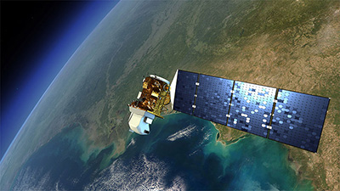
Purpose
I want to create this tool because it will be very helpful when I need to process up to 500 Landsat Geotiff raster datasets for my thesis research.
Notes:
Why do I need this application? It will be too timing consuming if I have to clip each raster to my study area one by one.

Slide 3
Functions
This tool clips multiple Landsat imagery to my study area, quantifies DEM by deriving aspect, contour, hillshades, and slope, and calculates the maximum, minimum, mean, and the sum of the input elevation value.
Clip Landsat Imagery (multiple)
Create Aspect/Contour/Hillshades/Slope
Calculate Max, Min, Mean, SD of Elevation
Notes:
I want to create a tool that can take a large amount of landsat imagery, clip it to my study area, then create aspects/contour/hillshades/slopes, and finally projects them to a designated projection.

Slide 4
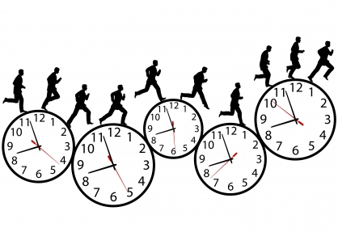

Benefits
Convenience: can deal with a great number of Landsat Geotiff raster datasets and process 3D analysis all at once.
Time saving: Significantly reduce the time amount that I need If I have to clip tons of raster images one by one.

Slide 5
Algorithms
The aspect algorithm calculates the slope direction.
aspect = 57.29578 * atan2 ([dz/dy], -[dz/dx])
The hillshade algorithm calculates illumination values for each cell in a raster.
Hillshade = 255.0 * ((cos(Zenith_rad) * cos(Slope_rad)) + (sin(Zenith_rad) * sin(Slope_rad) * cos(Azimuth_rad - Aspect_rad)))
The slope algorithm measures the degrees of slopes.
slope_degrees = ATAN ( √ ([dz/dx]2 + [dz/dy]2) ) * 57.29578

Slide 6
Test Data
Landsat imagery
Study area

Slide 7
Codes

Slide 8
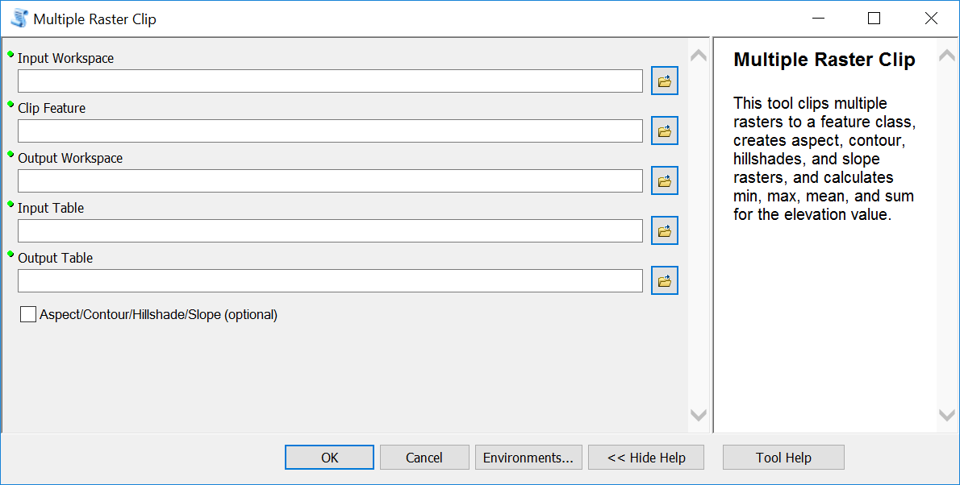

Slide 9
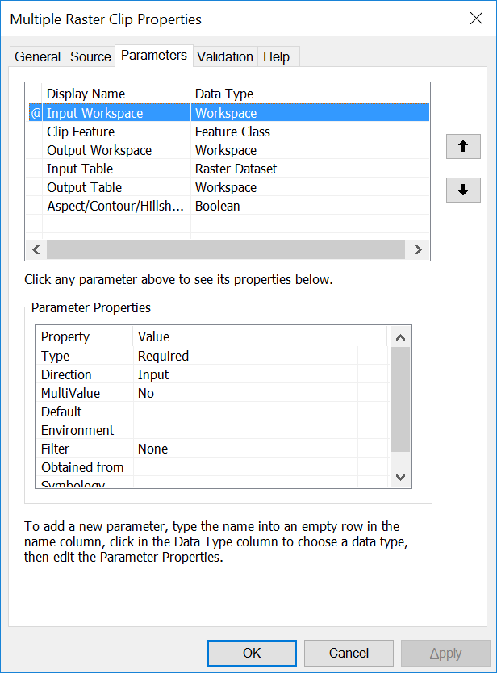

Slide 10
Results
Aspect
Contour
Hillshades
Slope

Slide 11
Results

Slide 12
Results

Slide 13
Thank you!
Questions?

